Slide 1

Viewport
Elliott Denis

Slide 2
Origin story
All came from call with virgin media

Slide 3
Resulting applications
eee

Slide 4
Name of company
Providing a view into a situation, viewport is a window, but we can also look at it as “view” + “portal”
Sharing a view or perspective or insight

Slide 5
Overview

Slide 6
Account types

Slide 7
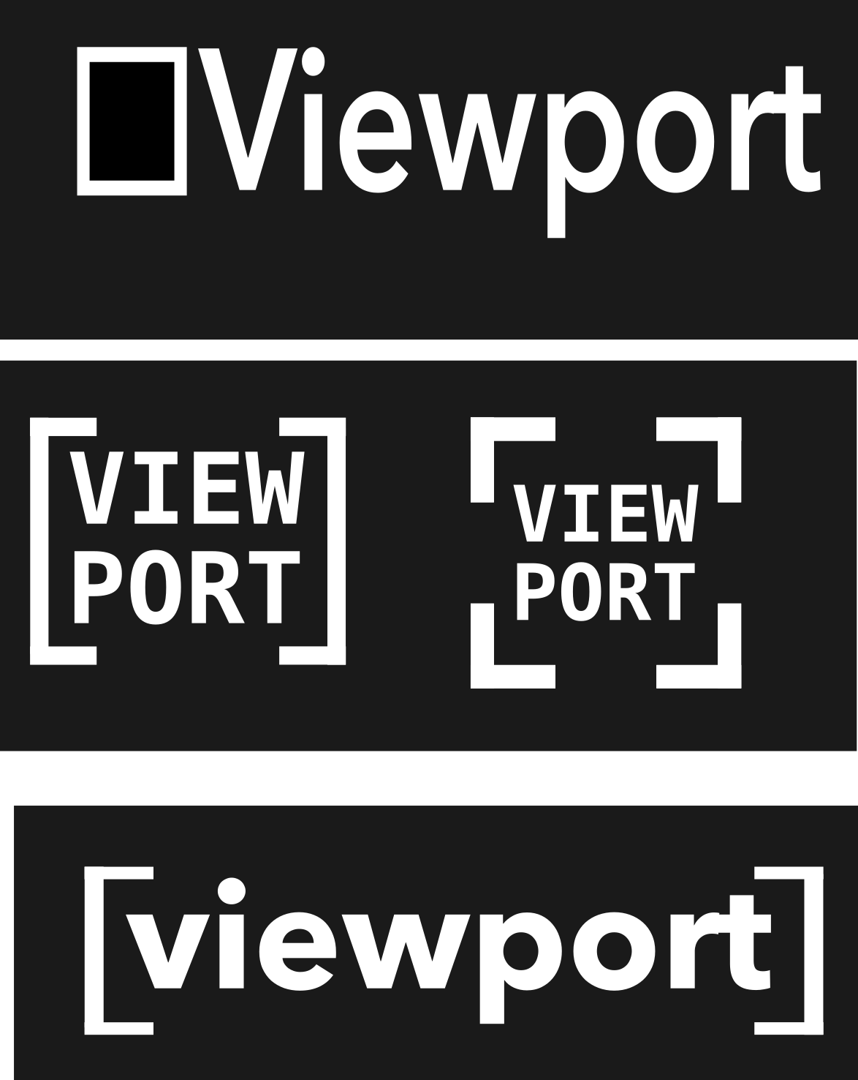
Logo Design Ideas
Colour scheme: black and white
Keep it simple and clear
Minimalistic – functional app
Font: Menlo and Avenir Next (bold)
Issue: youtube channel called viewport with similar square design but around the “O”
Mid row right could be the app logo

Slide 8
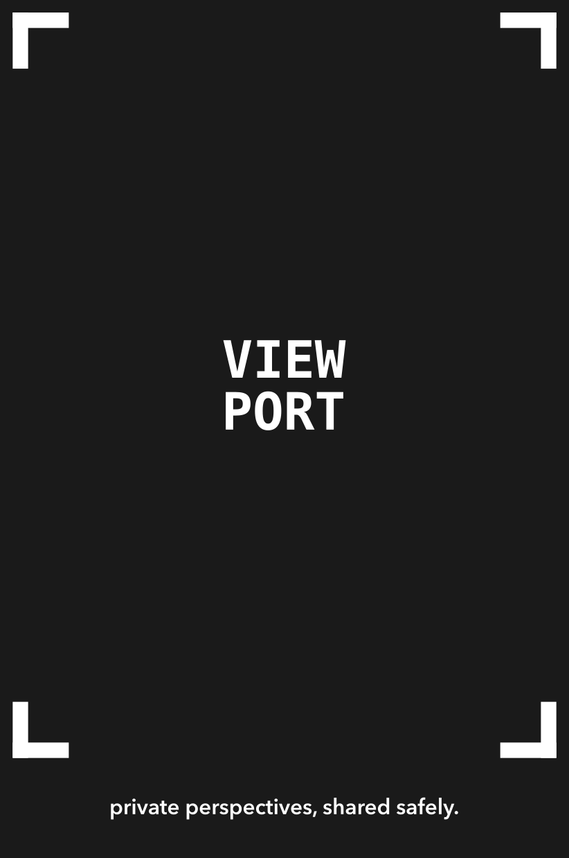
App Layout – Loading Screen
When opening the app and while it loads and connects to server
Show logo, tagline and the frame in which the camera of the phone will fit!

Slide 9
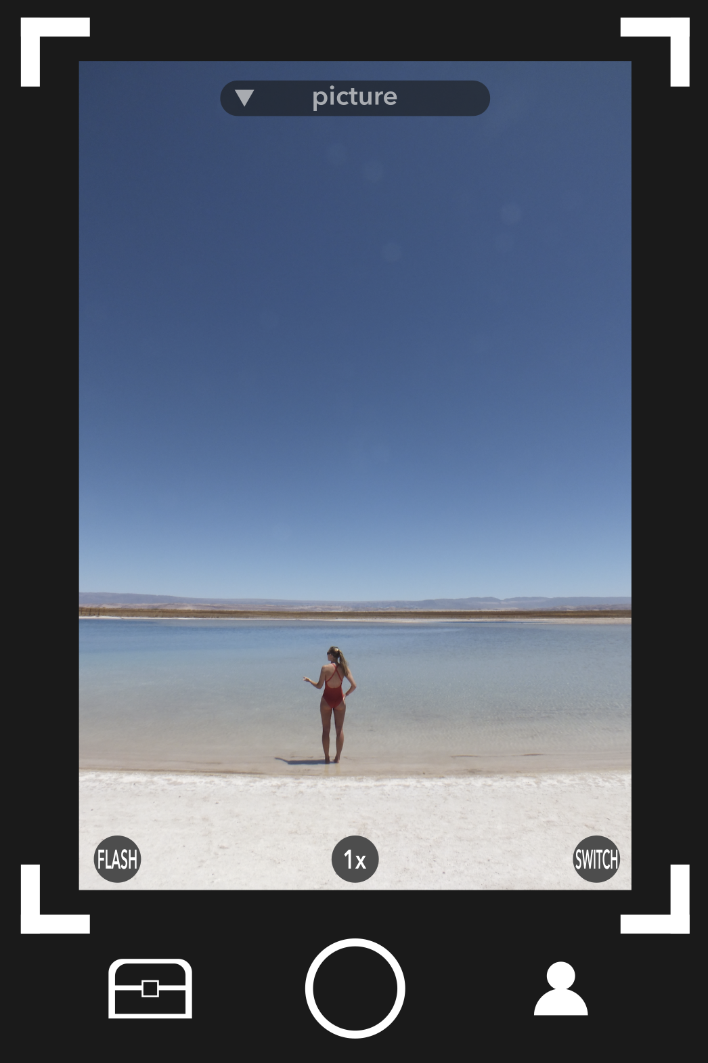
App Layout – Landing screen
After loading what we see
Land immediately on picture option s.t can be a quick sharing

Slide 10
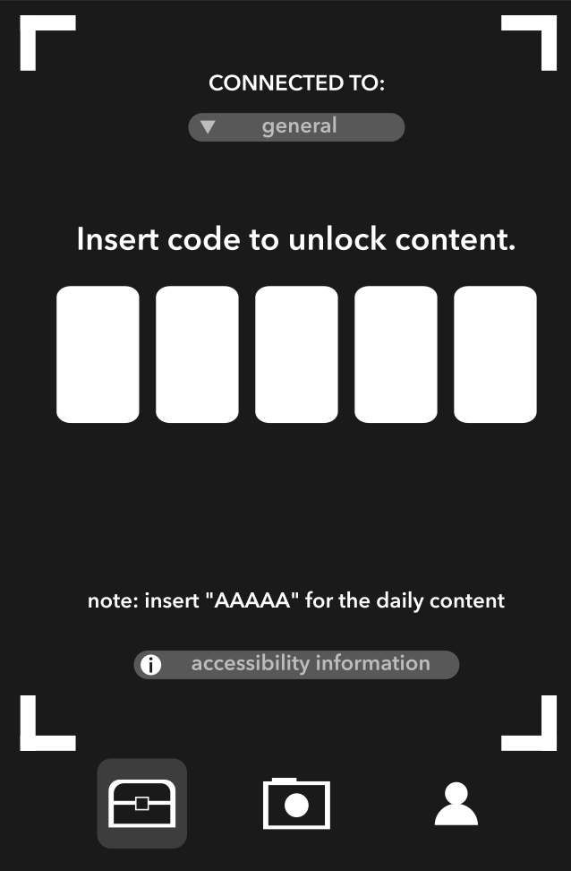
App Layout – Cipher screen
To access content that was sent
Either connect to “general” channel or your company or personal accounts (separate databases – at top of screen
Daily content shared and chosen by VIEWPORT where there can be a daily specific code (put forward anything we want)
Accessibility information to describe what you can have access to depending on account types …

